Slide 1
Peer-graded Assignment: Capstone Project - The Battle of Neighborhoods (Week 2)

Slide 2
the-battle-of-neighbourhoods
1. Introduction/Business Problem
The idea of this study is to help people planning to open a new restaurant in Toronto to chose the right location by providing data about the income and population of each neighborhood.

Slide 3
2. Downloading and Prepping Data
To provide the stakeholders the necessary information I'll be combining Toronto's 2016 Census that contains Population, Average income per Neighborhood and Foursquare API to collect competitors on the same neighborhoods.

Slide 4
3. Methodology Methodology section which represents the main component of the report where you discuss and describe any exploratory data analysis that you did, any inferential statistical testing that you performed, and what machine learnings were used and why.

Slide 5
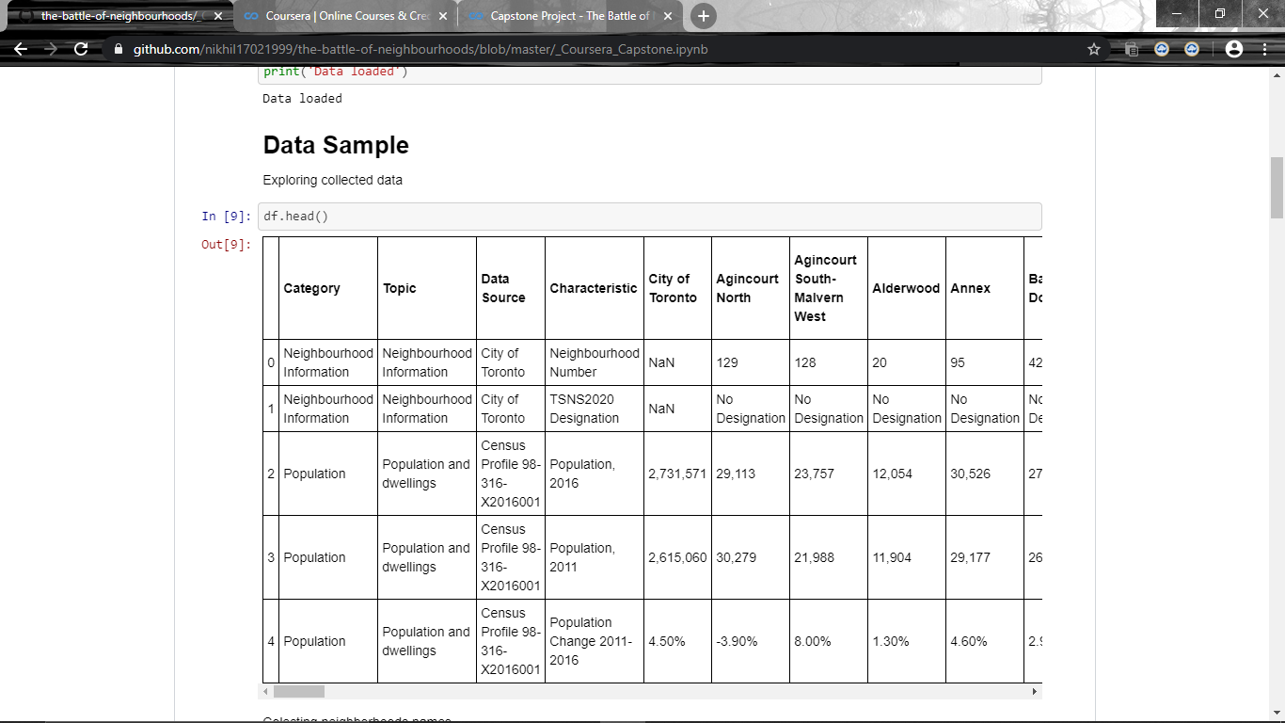

Slide 6
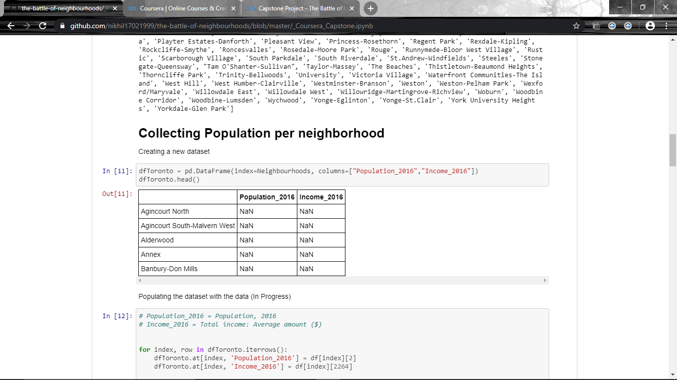
Collecting Population per neighborhood

Slide 7
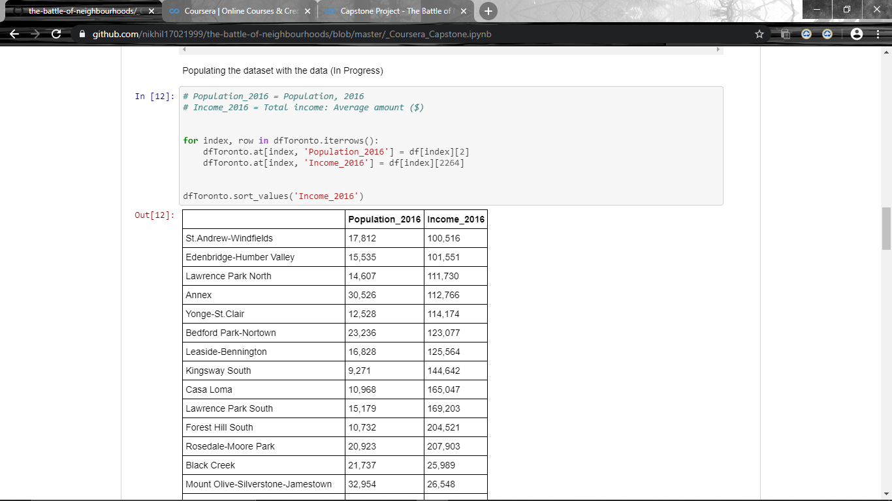
Populating the dataset with the data (In Progress)

Slide 8
4. Discussion section where you discuss any observations you noted and any recommendations you can make based on the results.
When I first decided to create this study I was expecting to find something else of restaurants in certain regions and result didn't meet that expectation.

Slide 9
5. Conclusion section where you conclude the report.
This report may be helpful for someone planning on opening a restaurant in Toronto, by comparing the current offers and neighborhoods profiles, however it may not cover all variables such as access to public transportation or even the restaurants profiles, so it shall not be used as a single decidion making tool.

Slide 10

THANK YOU!!!!

